Slide 1



WebRTC
Bring Your Own Number API (BYON)

Slide 2

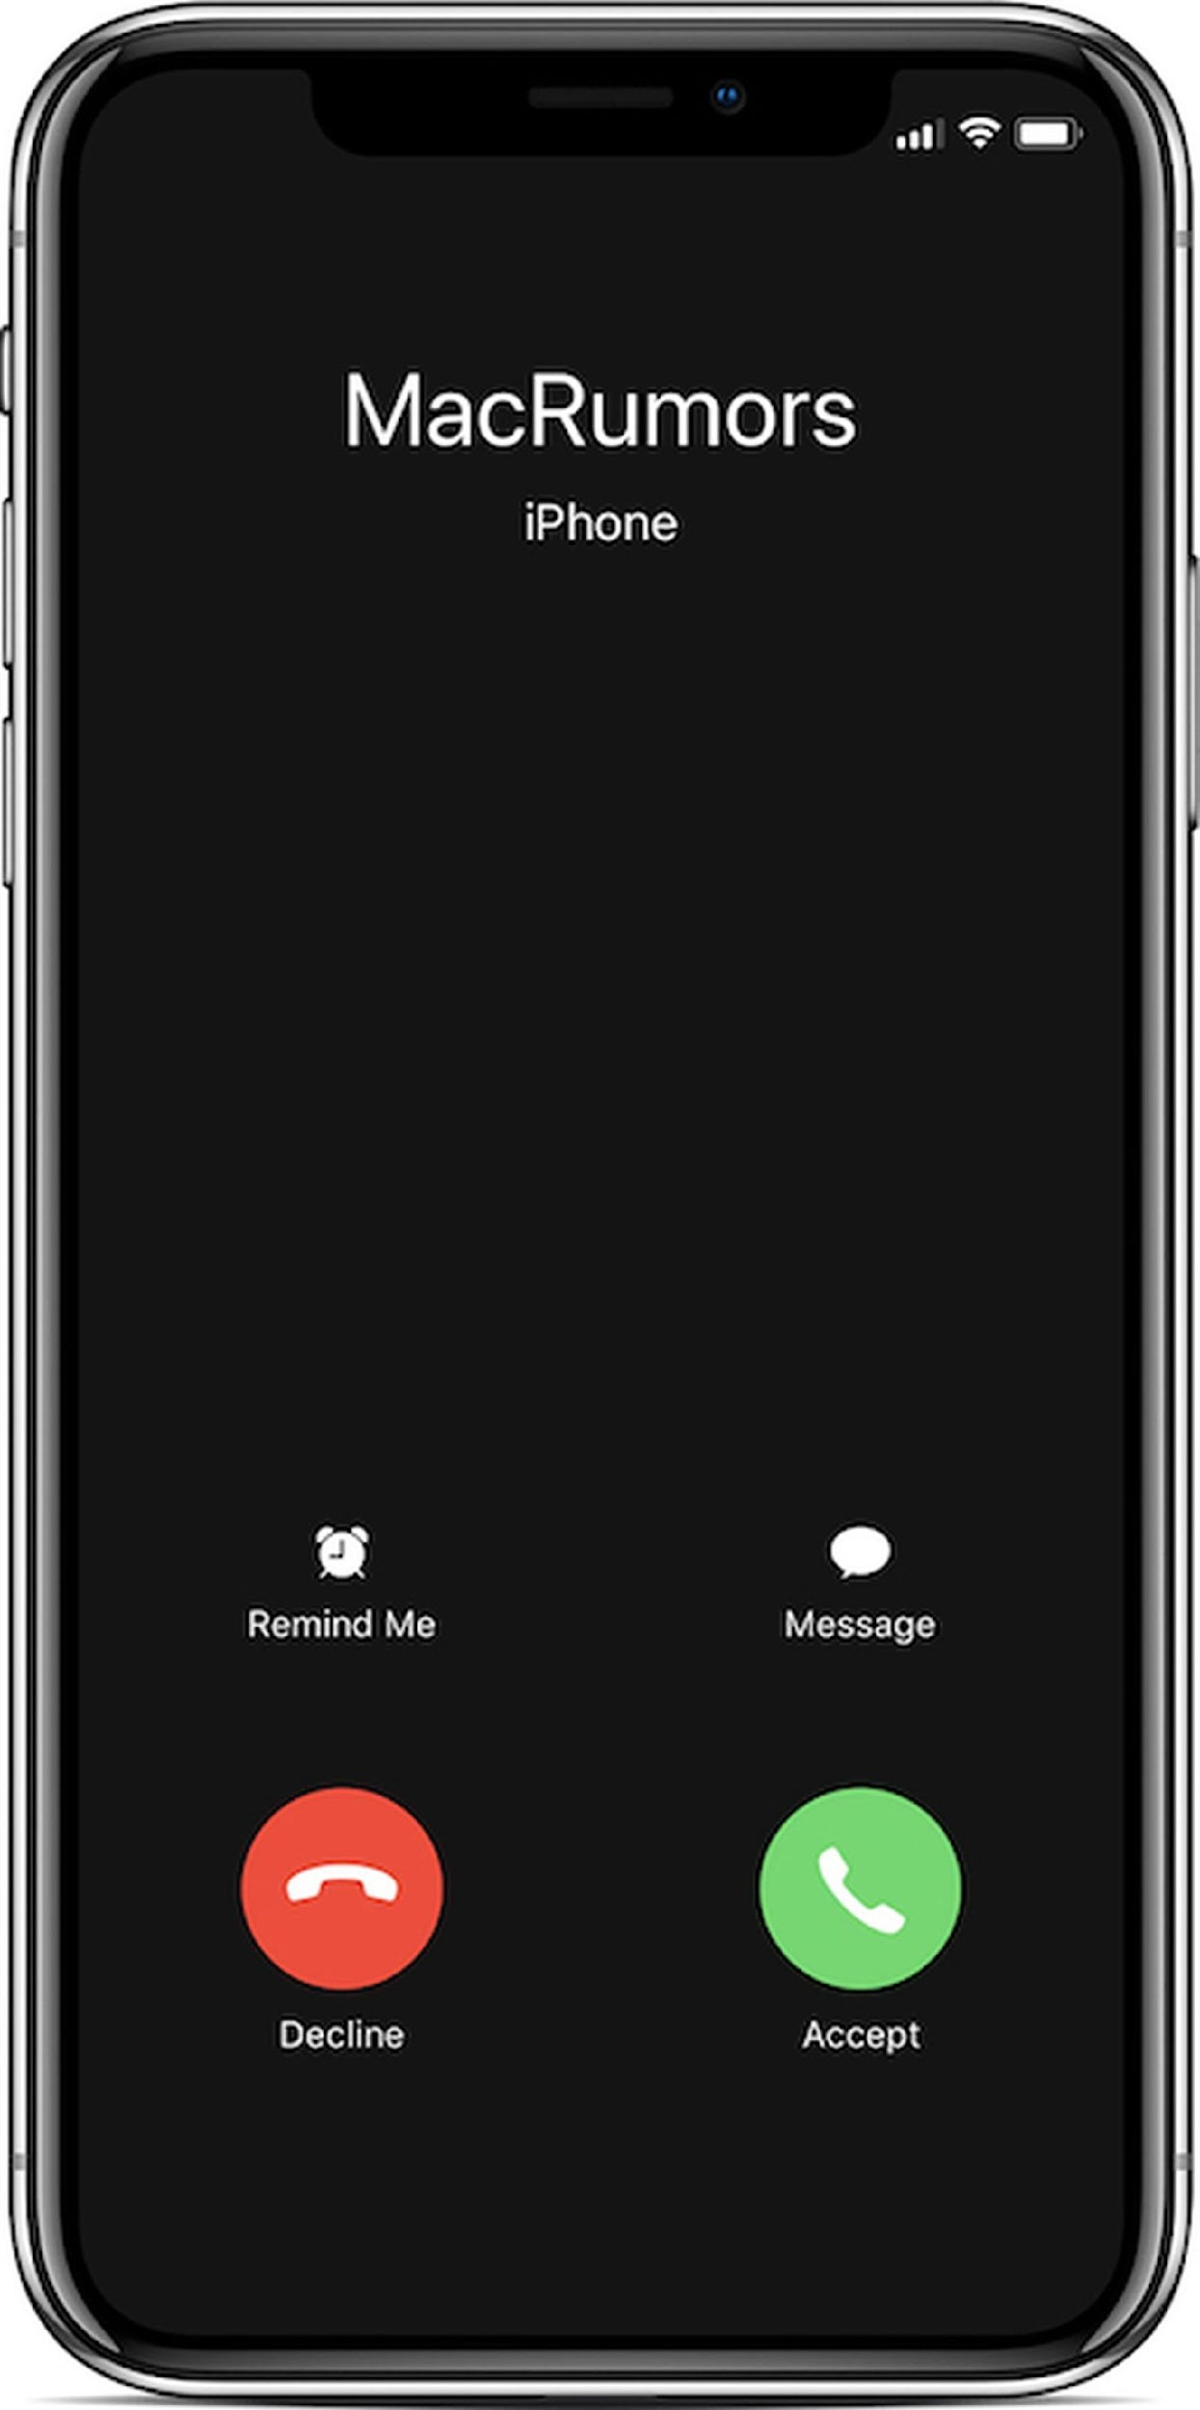

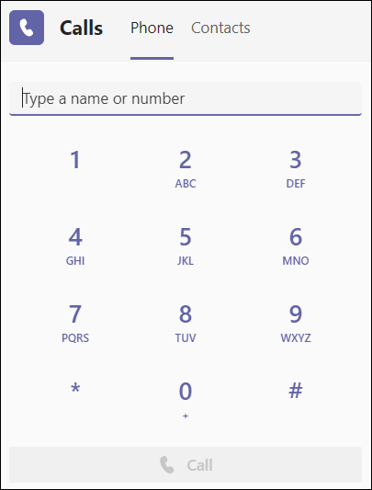
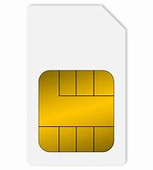

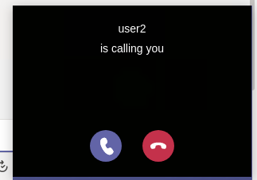
BYON
High Level Description – Value proposition
New functionality for webRTC services: Integrate BYON API to maintain your number in outbound and inbound calls from web comms service
Recipient receives call as if it was from User’s normal phone number
Maintains common number through web comms service and standard subscription
Facilitates number recognition and call-back for co-workers, partners and/or clients
User
601 01 01 01
A
Dials call to phone number from web comms service
Out-bound calls
Mobile phone:
601 01 01 01
webRTC API with
BYON API integration
User
Receive phone calls simultaneously on phone subscription and web comms service
Presents “Occupied user info to caller user is already in phone call
Facilitates number recognition and call-back for co-workers, partners and/or clients
601 01 01 01
911 40 40 40
A
Dials call to phone number
Mobile phone:
601 01 01 01
In-bound calls
911 40 40 40
webRTC API with
BYON API integration
© 2023 Telecom Infra Project, Inc

Slide 3

BYON
WebRTC Gateway Overview
BYON and other use cases is realized through the webRTC Gateway deployed to extend the network voice services to any web-based client or non-simcard device
This element provides:
Interworking between the web-based world and the IMS world
An API for the Control Plane of IMS for web apps
A standard WebRTC interface for media.
IMS
webRTCGW
SIP signalling
IMS
Client SDK
Client SDK Vendor1
REST API
webRTCGW
vendor agnostic
Client SDK Vendor2

Slide 4
BYON
The API Challenge: From Propietary to Standard
The UNI interface for the control plane needs to be defined and standardized . This interface manages registration and making and receiving calls.
SIP signalling
IMS
Vendor proprietary REST API
Client SDK
Client SDK Vendor1
webRTCGW
vendor agnostic
Client SDK Vendor2
SIP signalling
IMS
Client SDK
STANDARD REST API
webRTCGW
Standard API
The Vendor proprietary APIs today are normally based on REST APIs , JSON over WebSockets or SIP over WebSockets
© 2023 Telecom Infra Project, Inc

Slide 5
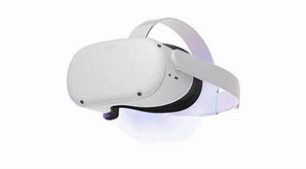
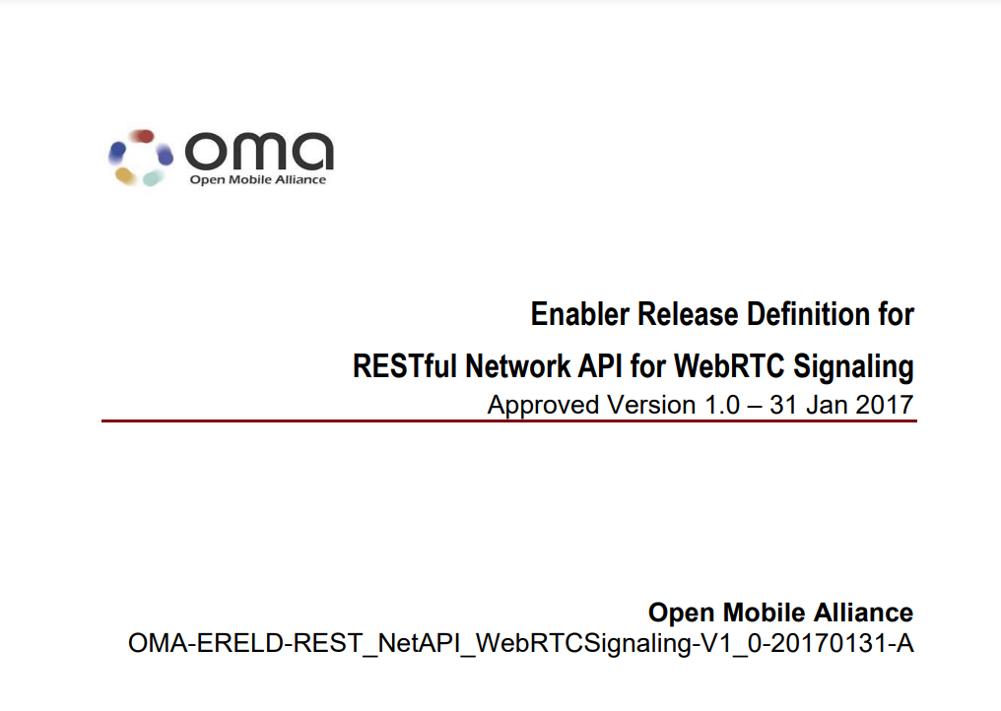
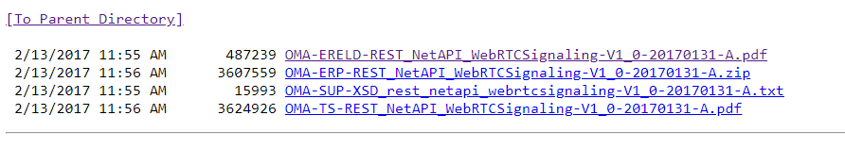
BYON
CAMARA
In TIP we have worked with Mavenir and other partners in a simplification of the existing webRTC control plane API from OMA.
Existing control plane API from OMA: REST_NetAPI_WebRTCSignaling/
The simplification intends to reduce complexity for non telco developers.
Therefore: a REST API utilizing JSON over Websockets for the delivery of asynchronous call events.
SIP over WebSockets is discarded due to the complexity for developers.
The API provides methods to register, receive and make calls.
© 2023 Telecom Infra Project, Inc

Slide 6
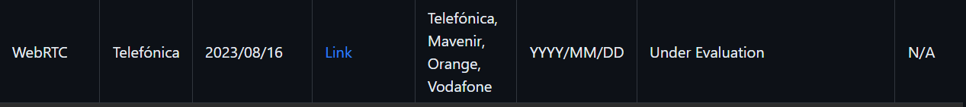
BYON
CAMARA
A request to CAMARA for the API has been formalized by Telefónica and supported by Mavenir, Vodafone and Orange. #280.
Partners such as Ericsson, DT and Oracle are finishing their analysis of API support.
BYON- CallHandling-Service
BYON- RACM- Service
APIproposal_WebRTC_Telefonica
© 2023 Telecom Infra Project, Inc

Slide 7
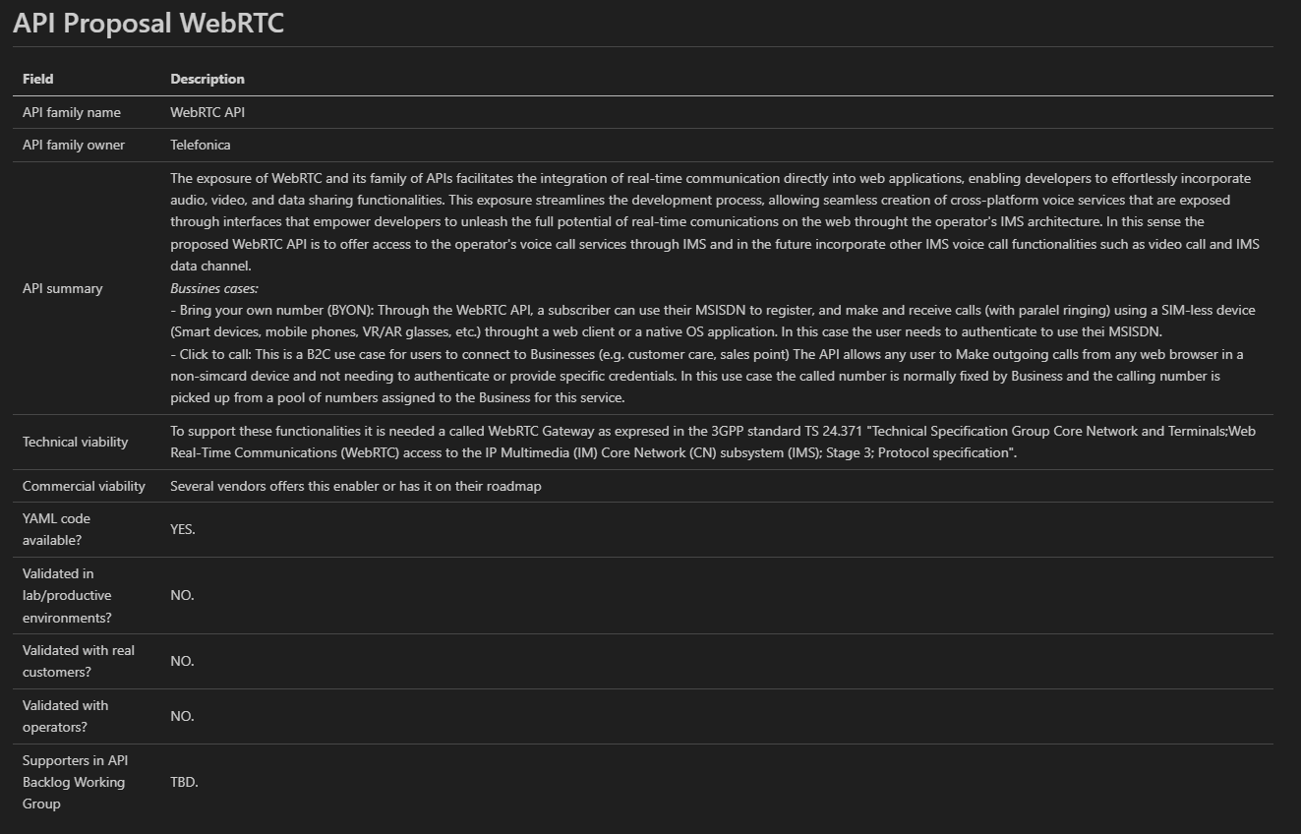
BYON
APIproposal_WebRTC_Telefonica.md
© 2023 Telecom Infra Project, Inc

Slide 8
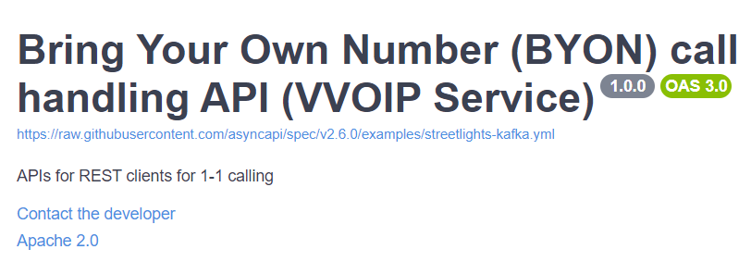
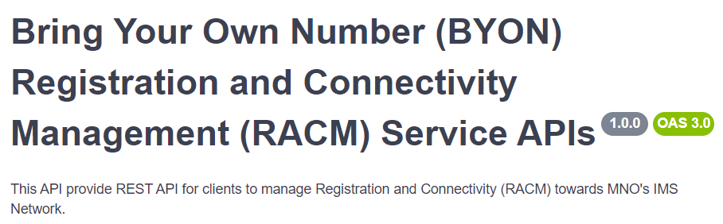
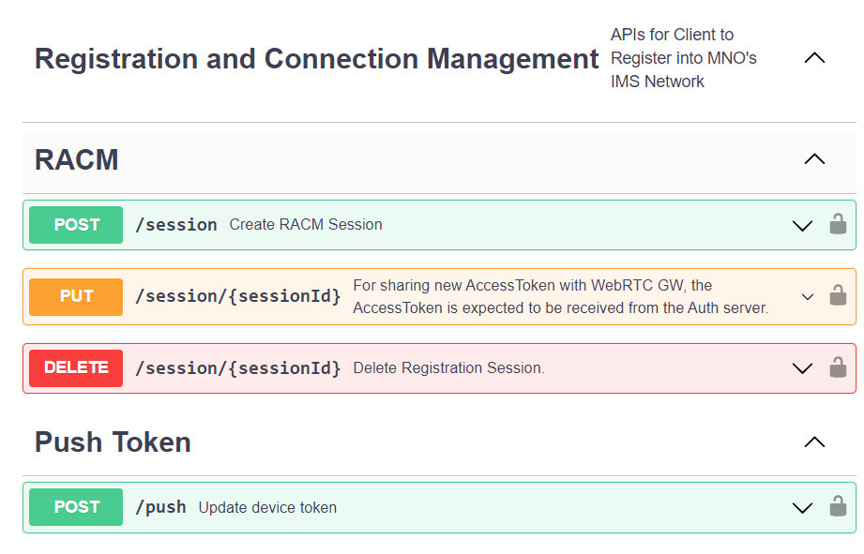
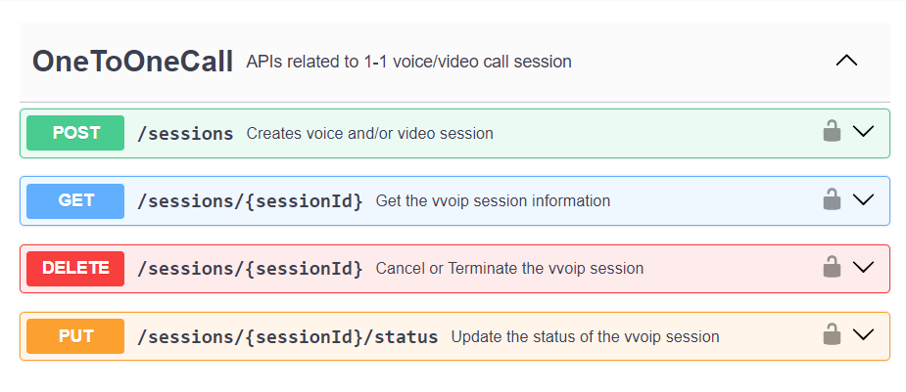
BYON
API Structure
© 2023 Telecom Infra Project, Inc

Slide 9
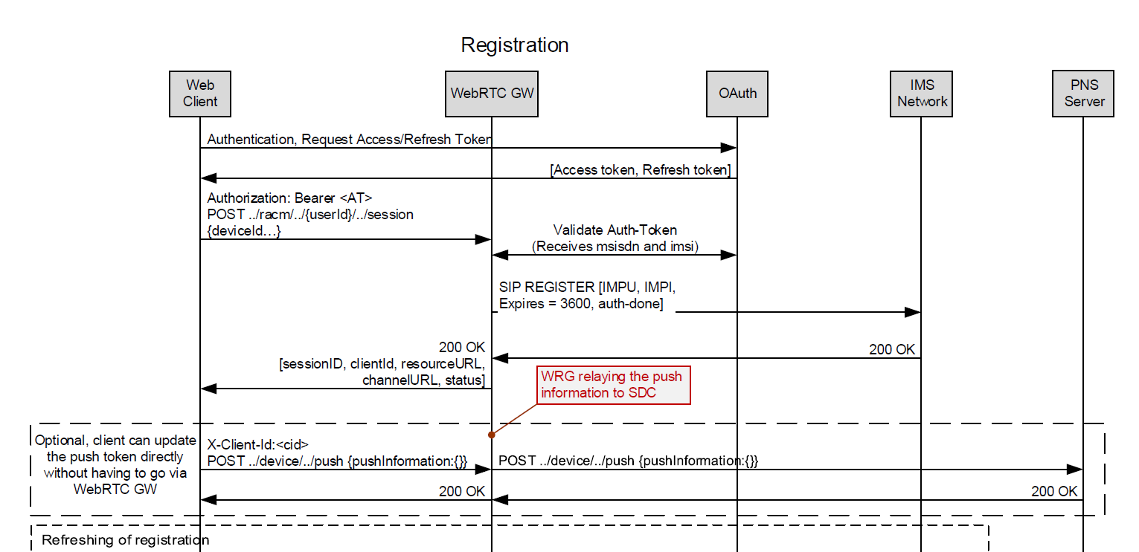
BYON
Low Level Flows - Registration
© 2023 Telecom Infra Project, Inc

Slide 10
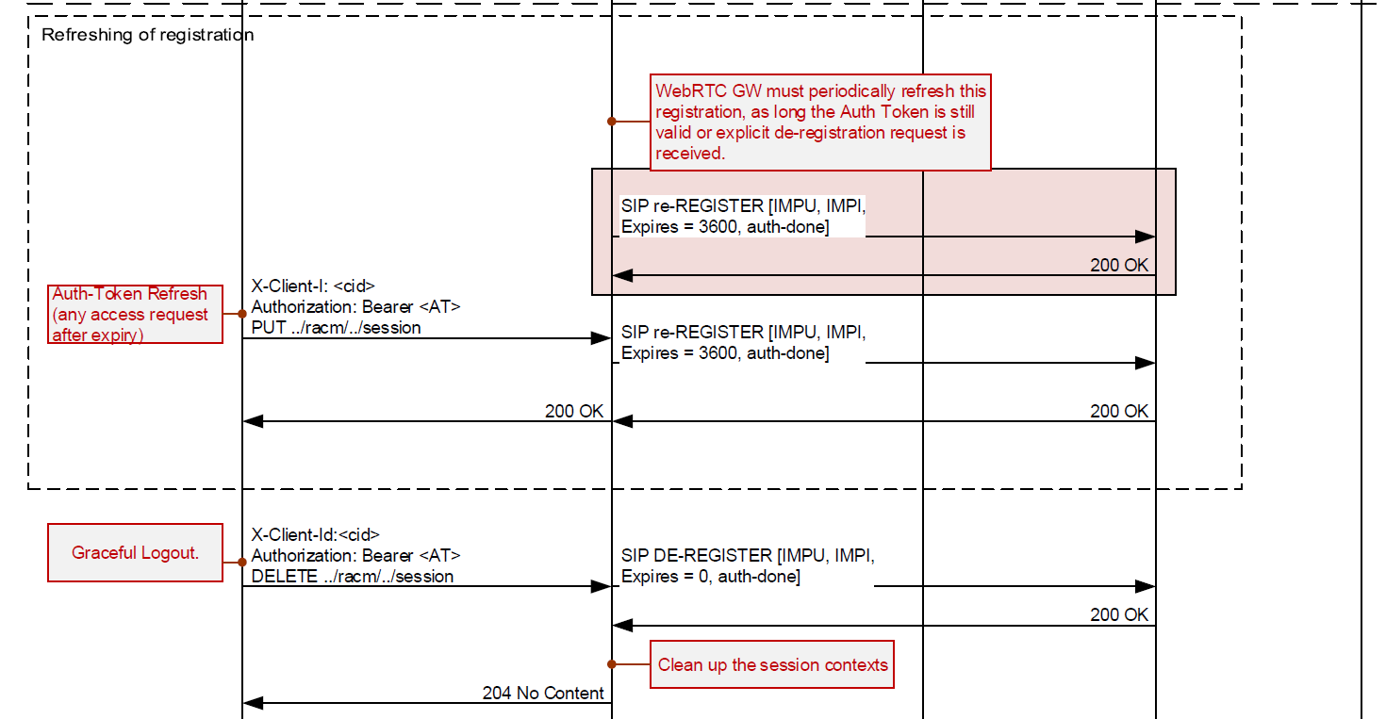
BYON
Low Level Flows - Registration
© 2023 Telecom Infra Project, Inc

Slide 11
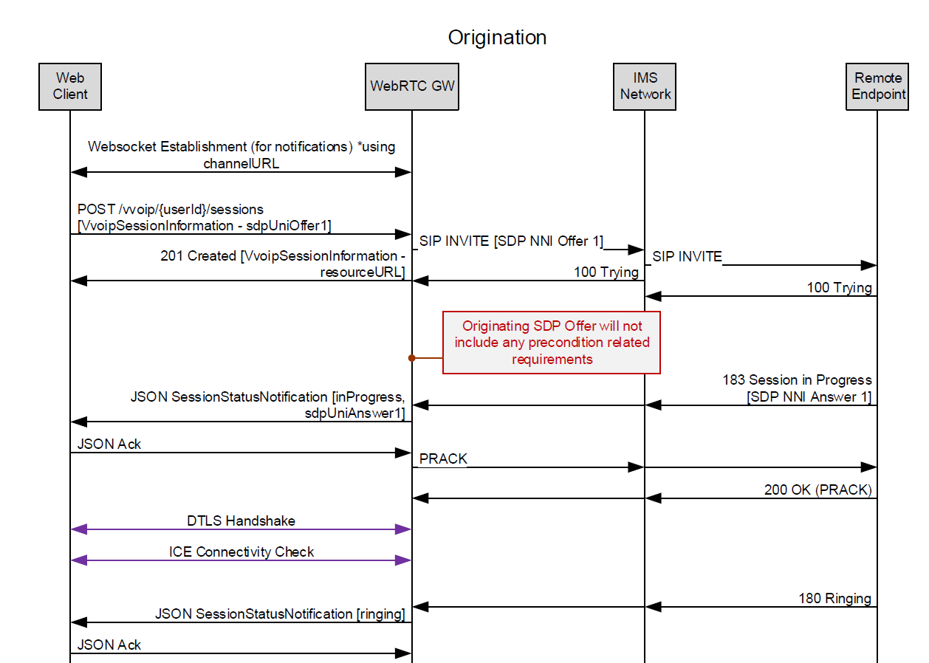
BYON
Low Level Flows - Origination
© 2023 Telecom Infra Project, Inc

Slide 12
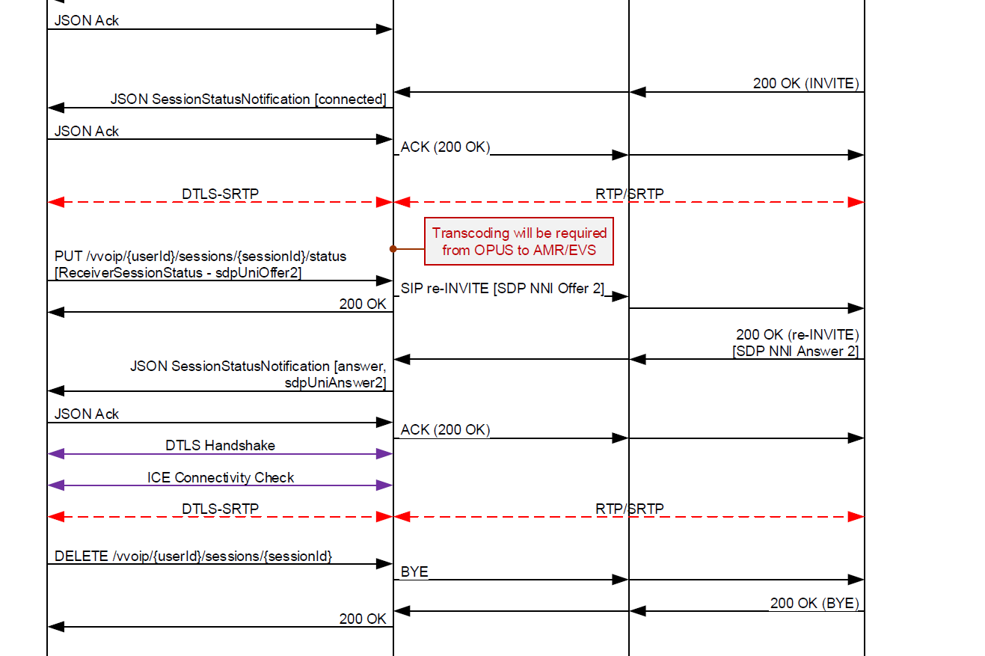
BYON
Low Level Flows - Origination
© 2023 Telecom Infra Project, Inc

Slide 13



